Slide 1
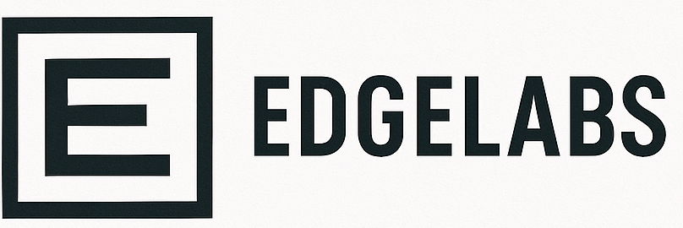
NEEDS A DESIGN SCHEME
KEEPING IT AS WHITE FOR NOW
WILL LOOK AT CANVA
LOGO AND NAME AS PLACEHOLDERS
High-impact automation.
Solutions that cut wasted time, reduce costs, and scale your business.

Slide 2

The Problem
Manual processes, bottlenecks, and inefficiencies drain capacity, slow growth, and frustrate teams.
Common pain points experienced by UK companies:
40% of UK SMEs cite manual admin as their #1 barrier to growth
Hidden costs pile up — storage, errors, delays, lost revenue.
The average SME employee wastes 6+ hours/week on avoidable tasks
Inefficient customer journey – bookings, enquiries, or sales processes are inefficient
Siloed systems – tools don’t talk to each other, causing duplication, rework and errors
80% of automation ROI is realised in <12 months
EdgeLab cuts the waste and turns inefficiencies into productivity gains

Slide 3





From Bottlenecks to Working Automation
“We diagnose. We design. We build. We optimise. We empower.”
Discover inefficiencies
Roadmap
Build Fast
Scale Impact
Empower Teams
Find wasted time, expose efficiencies & bottlenecks.
Build an automation roadmap
Deliver working solutions fast
Scale and Optimise
Train your team to own it
Expose the inefficiencies. Quick wins in weeks.
Sharp, prioritised roadmap: what to automate first, ROI case, where to start.
Live systems in weeks, not months (booking, invoicing, dashboards, AI copilots).
Track ROI, cut errors, expand impact.
Make your team automation-ready, no consultant dependency.
Pain point map + immediate action list.
Investment case with ROI.
Booking systems, invoicing, dashboards, AI copilots.
Savings and productivity gains.
Workshops, training, toolkits

Slide 4



Case Studies - NHS
Challenge
Impact
Autism Spectrum Disease diagnostic waits escalating, with ~1,000+ children on the list and many approaching 104 weeks.
Current pathway running at ~2× gold standard (5.8h vs 2.5–3.5h per assessment); clinicians doing admin; non-standard reporting.
Core capacity and skill-mix misaligned; recruitment lags make “more staff only” solutions slow to bite.
Backlog compression and >52-week waits reduced; pathway stabilised against ongoing demand.
~60% time reduction per assessment (5.8h → ~2.25h); ~2.5× throughput with existing workforce.
Solution
Re-engineered pathway to gold standard, introducing AI tools (speech-to-text, auto-scoring, templated reporting) to cut clinician time to ~2.25 h.
AI-enabled pathway: speech-to-text, auto-scoring, templated reporting integrated with EHR to reduce clinician time to ~2.25h/case while maintaining governance/quality.
Targeted redesign to benchmark: reallocate tasks to Bands 3–5, standardise templates/SOPs, optimise clinic flow.
Sets foundations for a Neurodiversity Hub model (ASD/ADHD) and sustained performance
~£1.5m net annual contribution (scalable to ~£4.5m with expanded workforce)

Slide 5



Case Studies - SME
Impact
Challenge
40% efficiency increase in service throughput
Manual booking system limited garage throughput (2 bays fully utilised, overflow stock of cars waiting for service, storage and cost pressures).
Reduced car storage costs and improved site safety
Solution
Bespoke digital booking system aligned demand with capacity, introduced a third bay, optimised scheduling, and reduced waiting stock
We delivered a bespoke booking system that unlocked a third service bay, increasing efficiency by 40%, cutting costs, and improving customer experience
Better customer experience with predictable turnaround times
Owner reports smoother cash flow and reduced admin load

Slide 6

Why ?
Automation that delivers real results
What we do best:
Process redesign & mapping – uncover inefficiencies and restructure workflows.
Automation strategy – define the ROI and prioritise the quick wins.
AI integration – apply speech-to-text, auto-scoring, and generative AI to real processes.
Bespoke automation builds (booking, invoicing, reporting, scheduling).
Custom dashboards & analytics (real-time performance visibility).
AI copilots & agents (handling repetitive tasks and decisions).
Workflow integrations (connecting tools like Airtable, Power Automate, Python builds).
Training & capability uplift (so clients aren’t dependent on consultants).
Why it matters: Proven impact | Rapid delivery | Scalable growth

Slide 7
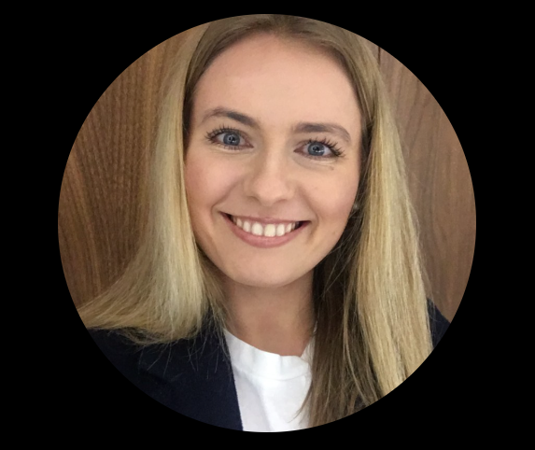
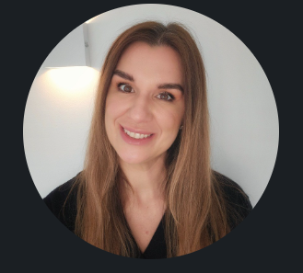
Who We Are
Experienced builders with a track record of delivery in AI, automation, and transformation.
Joanna Cholas, Director
Banking product strategist and digital solutions lead. Experienced in building automation, analytics dashboards, and AI integrations across public and private sectors. Hands-on delivery of bespoke systems that unlock growth.
15+ years delivering large-scale transformation and complex AI automation in the public and private sector
Proven track record: £3m+ savings delivered, supply chains built, digital solutions implemented
Boutique scale - hands-on expertise and rapid delivery,
Network of developers and automation specialists ready to scale with client needs
Izzy Holdsworth, Director
Extensive experience leading large-scale NHS and national programmes. Specialist in service redesign, digital transformation, and AI adoption. Delivered £3m+ in cost savings and scaled supply chain innovations.
We build high-impact automation that frees time, reduces costs, and unlocks growth

